Slide 1
User Needs and Requirements Lightning Talk
sdmay25-26 Bryce Rega, Marek Jablonski, Gavin Patel, Jonah Frosch, Long Yu Cost-Effective and Easily Configurable High Voltage Motor Controllers for Automotive Use
October 15th, 2024

Slide 2
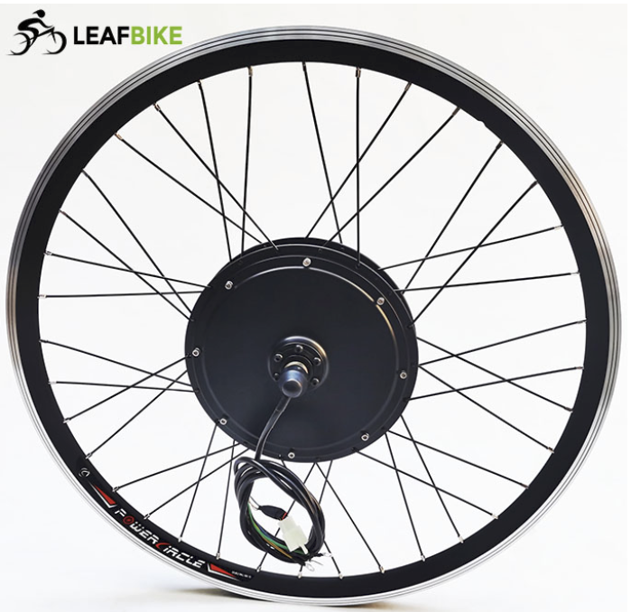
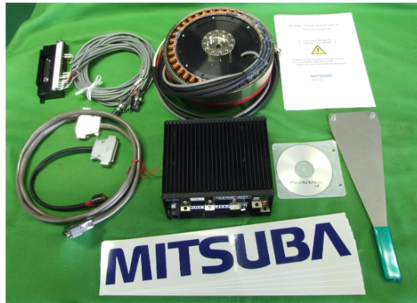
Project Overview
Custom High Voltage Motor Controller
Low Total cost for controller when compared to market options
Develop a GUI for interfacing and configuring controller
Compatible with many different applications

Slide 3
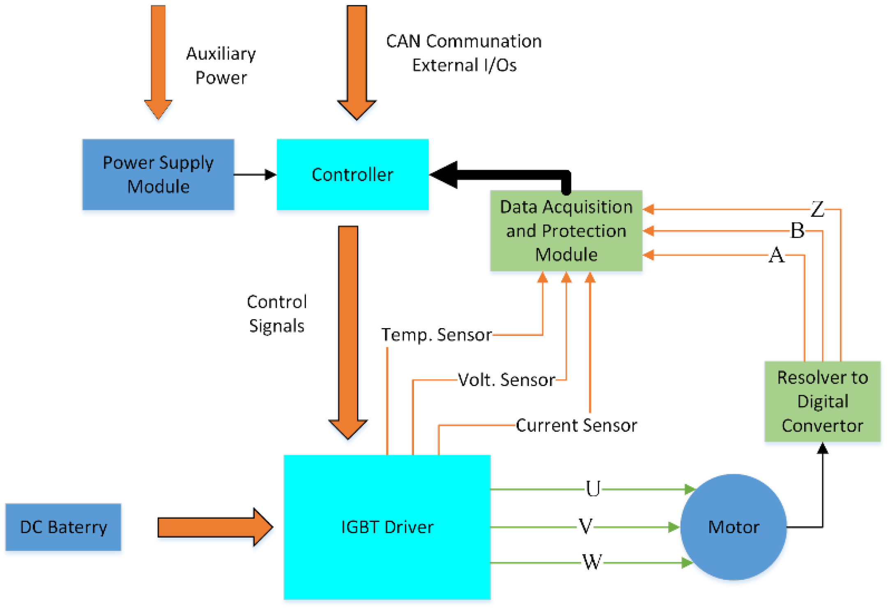
In this project will we be designing the architecture and implementation of a motor controller for lightweight automotive use.

Slide 4
User Needs
Jonah
Needs high power controller
Needs a high speed RPM output
Small Vehicle Engineer
Needs thorough documentation
Needs debugging access
Old Man McGee
Needs simple use instructions
Needs something low maintenance / reliable

Slide 5
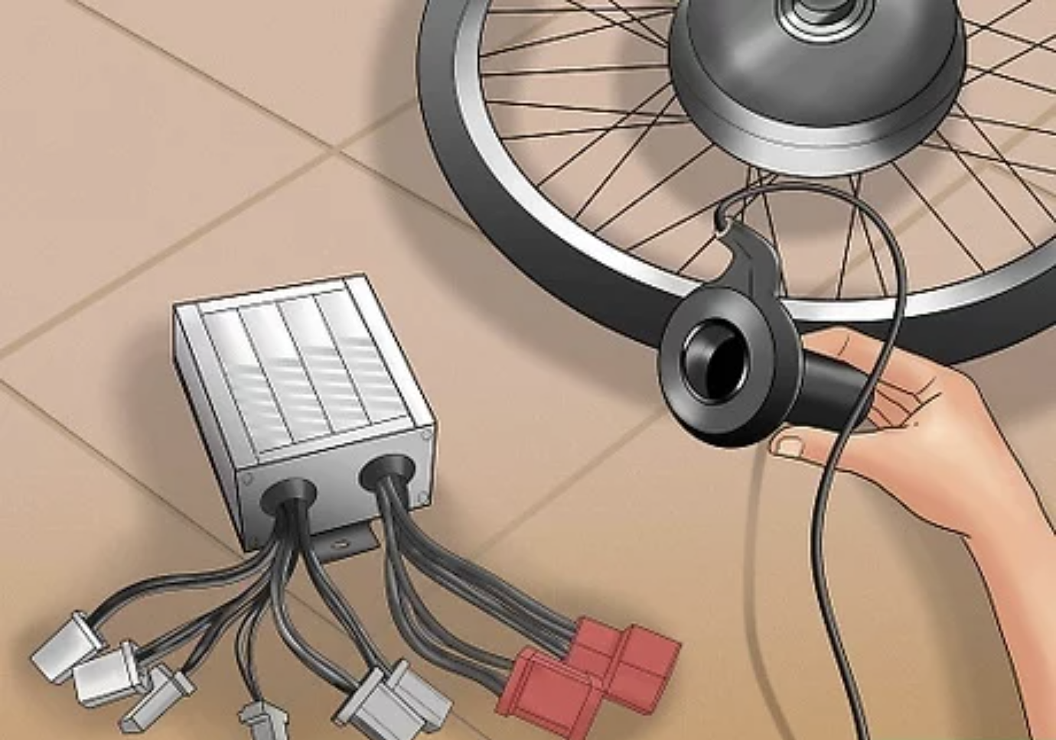
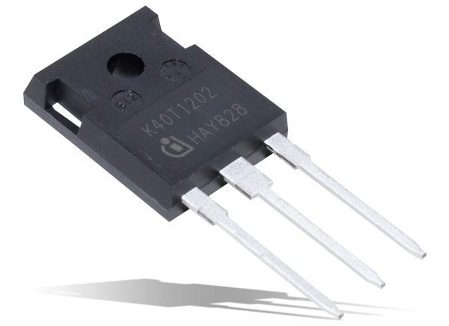
Requirements
Compact and lightweight
Could be put on a bike
Can be efficient for solar racing teams
Configurable
Configurable CAN bus options
Easy firmware updates
Safety
Check for shorts
Over temperature faults
No high voltage jumps
High power
MOSFET, IGBT drivers etc...
Cost-effective
Within the price range for DIY electric bike users
Be a fraction of the cost for solar racing teams (less fundraising required)
Meets Engineering Standards
Standards available on the next slide
Fits CAN standards for automotive applications

Slide 6
Engineering Standards
IEEE 1547 - Standard for Interconnecting Distributed Resources with Electric Power Systems
This standard outlines requirements for safely interconnecting distributed energy resources (like solar and wind) with electric power systems, focusing on performance, safety, and reliability.
IEEE 1149.1 - Standard Test Access Port and Boundary-Scan Architecture
This standard defines a boundary-scan architecture for testing and debugging integrated circuits and circuit boards, allowing access to internal signals for easier diagnostics without physical probes.
IEEE 1554 - Standard for Software Engineering in the Life Cycle of Digital Systems
This standard provides guidelines for software engineering throughout the life cycle of digital systems, emphasizing structured practices for development, Detroit testing, and maintenance to improve software quality and reliability.

Slide 7
Conclusion
We aim to develop a motor controller that applies to multiple applications. This required us to make a lightweight motor controller affordable, easy to use and adapt, and have plug-in diagnostics for troubleshooting. The intention is to do this while following relevant IEEE standards.

